Slide 1
Edge Detection Methods with Parallelization
CS526 Project
Members: Fuyao Wang, Mingdao Che, Pat Rick Ntwari.
April 2020
Boston University College of Engineering
Notes:
‹#›

Slide 2
Canny edge detector
Presentation Title
^{2/3/08 ‹#›}
Gaussian filter
Finding the intensity gradient of the image
Non-maximum suppression
Double threshold
Edge tracking by hysteresis
Notes:
‹#›
Canny edge detection is a technique to extract useful structural information from different vision objects and dramatically reduce the amount of data to be processed.
The Process of Canny edge detection algorithm can be broken down to 5 different steps:
Apply Gaussian filter to smooth the image in order to remove the noise
Find the intensity gradients of the image
Apply non-maximum suppression to get rid of spurious response to edge detection
Apply double threshold to determine potential edges
Track edge by hysteresis: Finalize the detection of edges by suppressing all the other edges that are weak and not connected to strong edges.

Slide 3
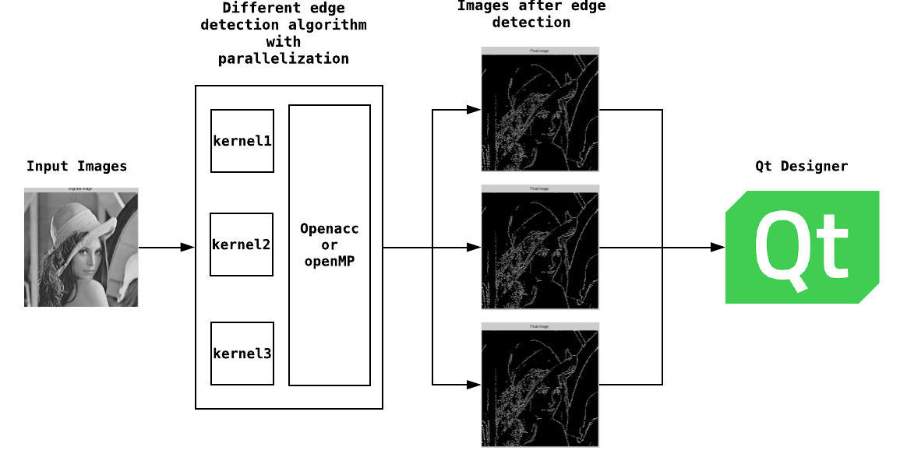
System Design:
Presentation Title
^{2/3/08 ‹#›}
Edge Detection kernels:
Cannys method(Sobel ,Prewitt , Roberts detectors)
UI Design:
C++ Qt Designer Implementation.
Boston University College of Engineering
Notes:
‹#›
Diagram:
Load images by pixel.
The canny module read these pixel to find the edge by parallel algorithm.
The UI call canny module with different kernels to show differences between the kernels.
Kernels:
We decide to use three different kernels: sobei, prewitt and Roberts.
The three kernels use different convolution formula to calculate gradients.
Qt Designer:
Qt Designer, a c++ friendly UI designer, is easy to operate.

Slide 4
Parallelization:
Presentation Title
^{2/3/08 ‹#›}
Individual kernel’s Paralization:
Edge gradient generator (step 2 of the Canny):
There exists opportunities to speed up the Canny’s method when calculate the edge directions by pixels.
Tracking edge process (Step 5 of the Canny):
According to the hysteresis’ method, the program is supposed to look through the “blob” to determine a strong edge pixel.
Boston University College of Engineering
Notes:
‹#›
Note: Red mark is the same things.
Tracking edge:
To achieve an accurate result, the weak edges caused by noise/color variations should be removed. Usually a weak edge pixel caused from true edges will be connected to a strong edge pixel while noise responses are unconnected. To track the edge connection, blob analysis is applied by looking at a weak edge pixel and its 8-connected neighborhood pixels. As long as there is one strong edge pixel that is involved in the blob, that weak edge point can be identified as one that should be preserved.
Blob:
blob analysis is applied by looking at a weak edge pixel and its 8-connected neighborhood pixels. As long as there is one strong edge pixel that is involved in the blob, that weak edge point can be identified as one that should be preserved.

Slide 5
Reference:
Presentation Title
^{2/3/08 ‹#›}
Canny edge detector: https://en.wikipedia.org/wiki/Canny_edge_detector
Canny Edge Detection - CSE@IIT Delhi
Notes:
‹#›

